Slide 1
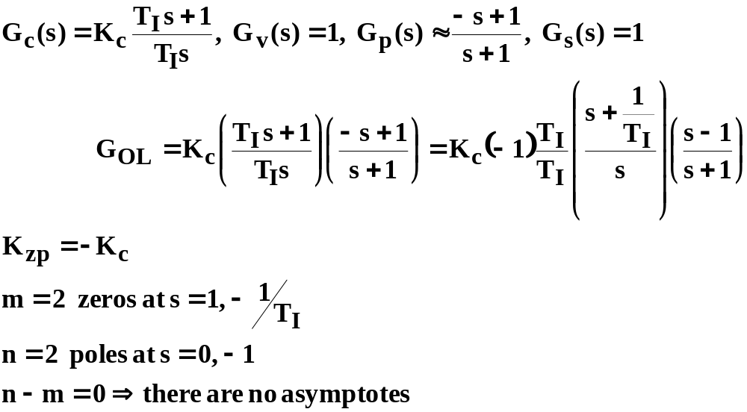
EXAMPLE 1: PI control of a 2-second delay step 1: put in required form, identify poles, zeros number of asymptotes:

Slide 2
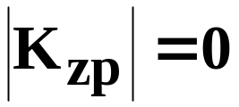
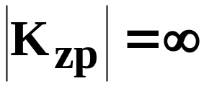
EXAMPLE 1: PI control of a 2 second delay
Step 4 and 5: Mark asymptotes and sketch possible locus as |K_{zp}| is increased (no asymptotes in this example)
s-plane
O
X
X
O

Slide 3
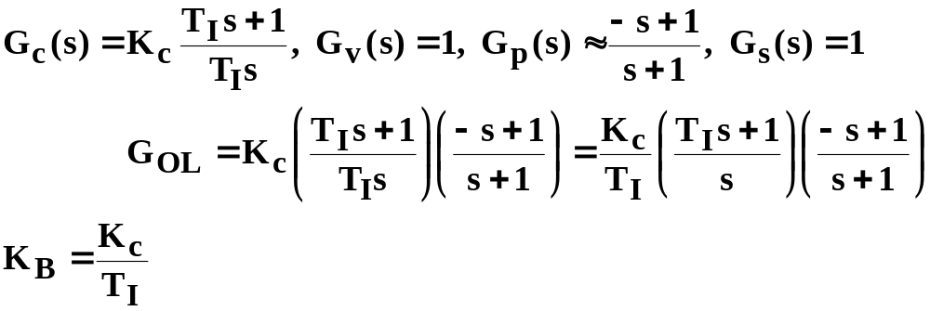
BODE ex. 1: PI control of a 2-second delay step 1: put in required form, identify break frequencies and characterisitics of all components
Numerator time constant breaks at ω_{b} =1/T_{I}, ω_{b}=|1/(-1)|=1
Denominator pole at the origin (1/s), and break at ω_{b}=1/1=1

Slide 4
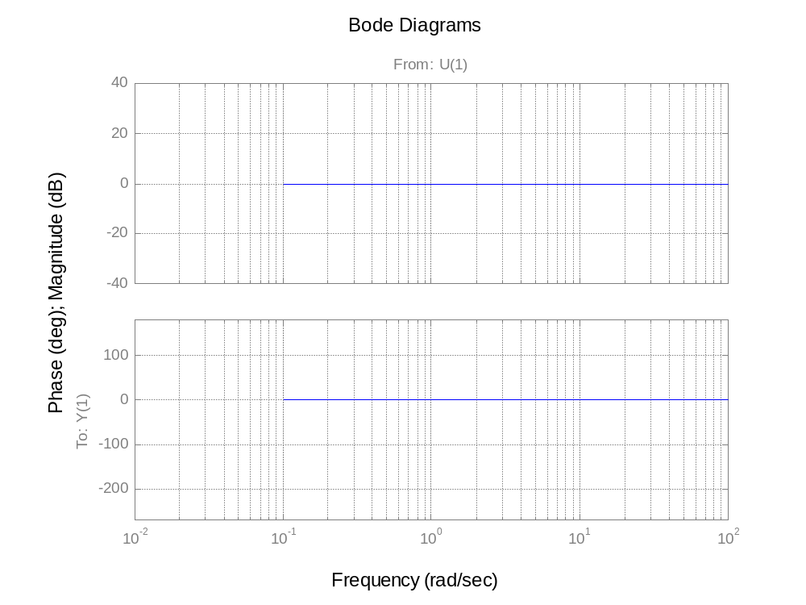
Numerator (-s+1) (phase goes to –90)
ω_{b}=1
Τ<0 phase goes to –90º
.01
.1
1
10
100

Slide 5
Denominator (s+1) added to diagram
|-s+1|
|1/(s+1)|
L[ -s+1]
L[1/(s+1)]
Numerator and denominator phase contributions are the same because τ<0 in numerator
.01
.1
1
10
100

Slide 6
Graphically add to get (-s+1)/(s+1) and show result with a solid line
Numerator and denominator mag.s add to zero
|-s+1|
|1/(s+1)|
Numerator and denominator phases add to twice the slope.
L[ -s+1]
L[1/(s+1)]
.01
.1
1
10
100

Slide 7
PI controller (T_{I}s+1)/T_{I}s portion; e.g., T_{I}=0.1
|1/0.1|
|0.1s+1|
|1/s|
ω_{b}=1/T_{I}=10
L[ 0.1s+1]
L[1/s]
L 1/0.1
.01
.1
1
10
100

Slide 8
Adding PI controller components together
20+40=60
Slope=-20
ω_{b}=1/T_{I}=10
Slope=-20+20=0
Slope changes by +20db decade at the break
Twice as many slope changes on phase plots because two “corners” per break
.01
.1
1
10
100

Slide 9
Adding (-s+1)/(s+1) and PI control
|(T_{I}s+1)/T_{I}s)|
|(-s+1)/(s+1))|
L(-s+1)/(s+1))
L(T_{I}s+1)/T_{I}s)
.01
.1
1
10
100

Slide 10
Adding (-s+1)/(s+1) and PI control
ω_{b}=1/T_{I}
.01
.1
1
10
100

Slide 11
Add in Kc< 1 for decent phase margin
Kc=-30db=0.032 needed for good phase margin
-150º
~30º PM
.01
.1
1
10
100

Slide 12
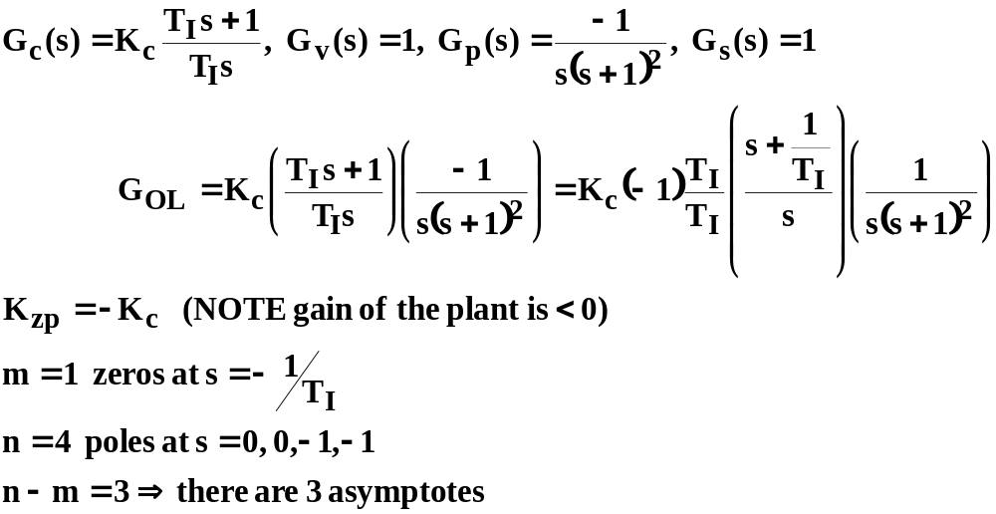
EXAMPLE 2: PI control with 3-asymptotes step 1: put in required form, identify poles, zeros number of asymptotes:

Slide 13
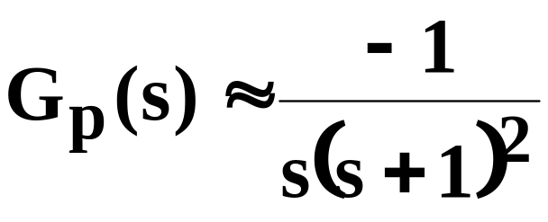
EXAMPLE 2: PI control with 3-asymptotes
Step 5: sketch possible locus as |K_{zp}| is increased with T_{I}=2
UNSTABLE for K_{c} too negative
X
X
O
X
X
REVERSE response plant needs REVERSE action controller (K_{c}<0)

Slide 14
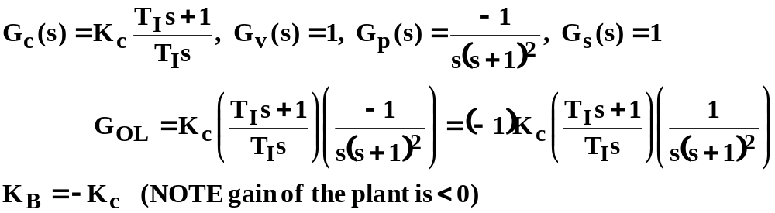
BODE Ex 2: PI control with 3-asymptotes step 1: put in required form, identify break frequencies and characterisitics of all components
In order to avoid a -180º phase contribution due to a negative Bode Gain, choosed Kc<0 with reverse action controller!!

Slide 15
1/[s(s+1)²] components
|1/s|
|1/(s+1)²|
L[ 1/s]
L[1/(s+1)²]
.01
.1
1
10
100

Slide 16
1/[s(s+1)²] with solid line
|1/s|
|1/(s+1)²|
Slope=-20-40=-60
L[ 1/s]
L[1/(s+1)²]
.01
.1
1
10
100

Slide 17
1/[s(s+1)²] and PI controller, T_{I}=10
1/[s(s+1)²]
1/T_{I}=.1
PI control
.01
.1
1
10
100

Slide 18
Maximize phase margin by choosing Kc=0.1
1/T_{I}=.1
Kc=.1 (-20 db)
.01
.1
1
10
100

Slide 19
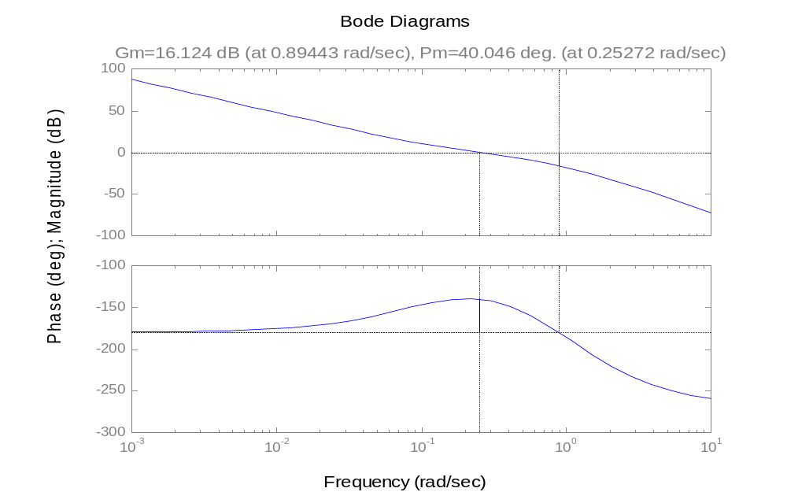
margin(0.25*[10 1],conv([10 0],[1 2 1 0]))
Gm=16 db, Pm=40º

Slide 20
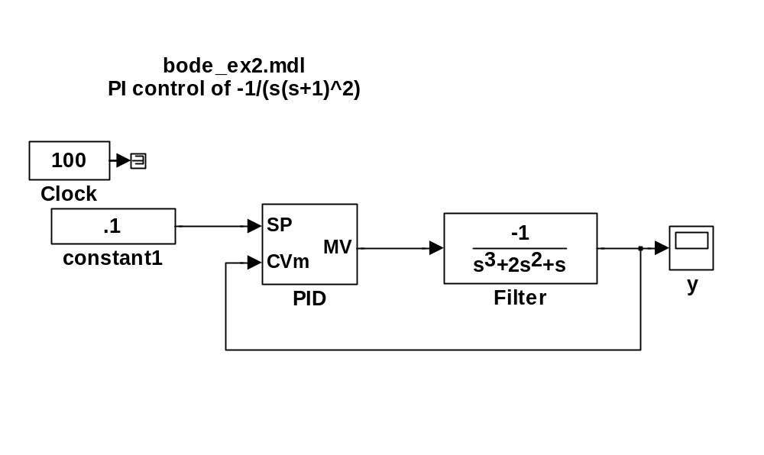
Simulation test with reverse action selected in the controller:
Kc=0.25, T_{I}=10

Slide 21
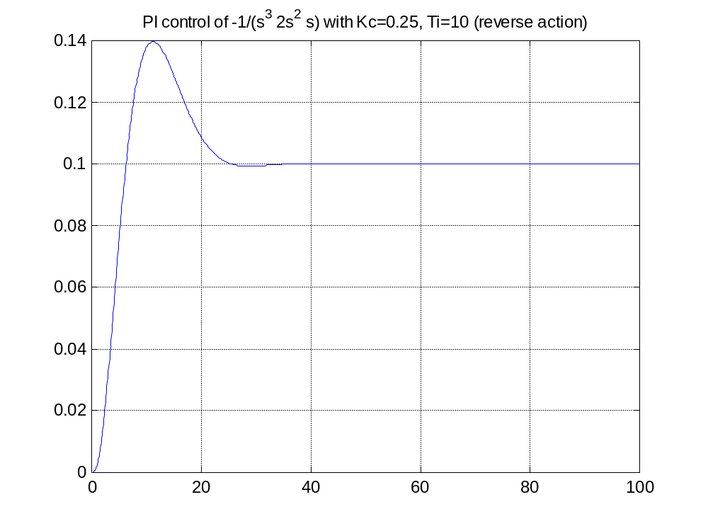
Response of PI of 1/[s(s^2 +1)]

Slide 22
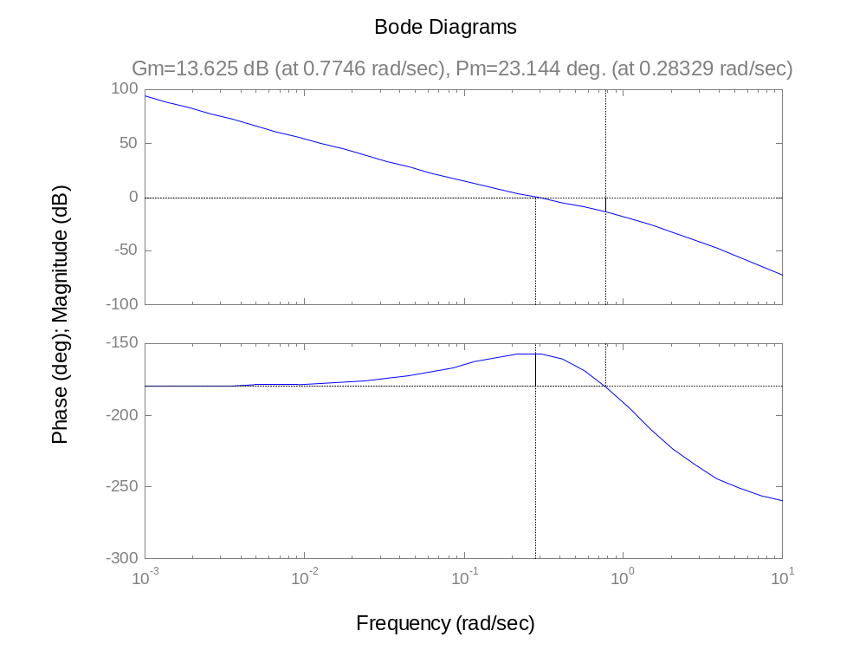
margin(0.25*[5 1],conv([5 0],[1 2 1 0])) maximum phase margin only 23º because the reset time is too short T_{I}=5

Slide 23
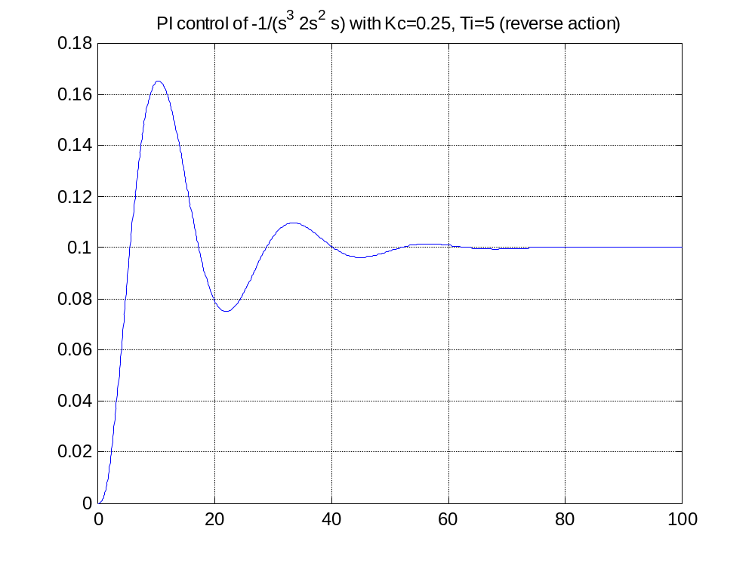
Response with T_{I}=5, K_{c}=0.25 and poor phase margin

